Slide 1

AR Blackjack Assistant
Remote Rendering Application
Team: ARAnnihilators
Membership: UCCS
Faculty Sponsor: Bill Michael
Faculty Sponsor: Dr. Dana Wortman
12/9/2022
Notes:
Hello, our team is the ARAnilhilators and for our senior design project design project, we decided to create an AR Blackjack Assistant rendering application.
Our original sponsor was Dr. Omid Semiari. He proposed a project that would design cutting-edge communication that would enable a host computer for its processing. By completing such an upgrade, we would use our application to show that an AR device, in our case, the HoloLens 1, would have prolonged battery life and increased memory availability.
In the beginning of the fall semester, our team learned that Dr. Semiari left UCCS. Due to this our team knew we needed to get another Sponsor that had skills that would pertain to this project. After some discussion, we decided to reach out to Dr. Dana Wortman, who is currently a senior instructor in Game Design and Development.
Even though we experienced some issues with our Sponsor early on, our team has communicated efficiently and effectively throughout the duration of this project.

Slide 2
Outline
Executive Summary
Problem Description
Conceptual Design
Final Design Description and Package
Testing and Analysis Summary
Project Planning and Management
Notes:
Today we will be going over our Final Report’s Executive Summary, Problem Description, Conceptual Design, Final Design Description and Package, Testing and Analysis Summary, and Project Planning and Management.

Slide 3
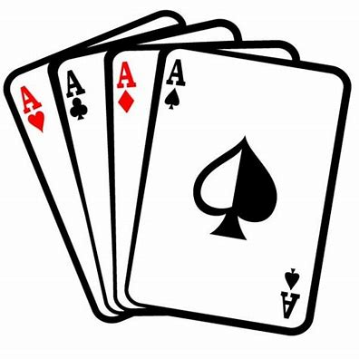
Executive Summary
Help a Novice Play Blackjack
Object Detection
Probability Determination
Interconnecting Code

Slide 4
Problem Description
Problem: Save AR power by offloading processing to another device; communication via WiFi.
Met Requirements:
Connection via WiFi for communication
Determine if player should hit/stand/split
Determine value of cards by dealer
Determine value of cards by player
Show probability of success for each move
Display graphic when hitting “21”
Display statistics for next move
Play sound
Identify playing cards from player
Display value of cards on table
Accompany a set of documents

Slide 5
Problem Description
Not Met Requirements:
Implemented using HoloLens
Total System Latency under 2 seconds
Improve runtime & battery life
Perform app rendering & processing on host computer
73.33% Success Rate

Slide 6
User Manual & Instructions
Hardware Operations
Unity Game Engine
Application Launches
Online Community Support

Slide 7
Bill of Materials
Microsoft Hololens (1st gen) | $810
WiFi 6 Netgear AX1800 Wireless Access Point | $40
Playing Card with Chips | $7
Total Cost | $857
Total Budget | $1000

Slide 8
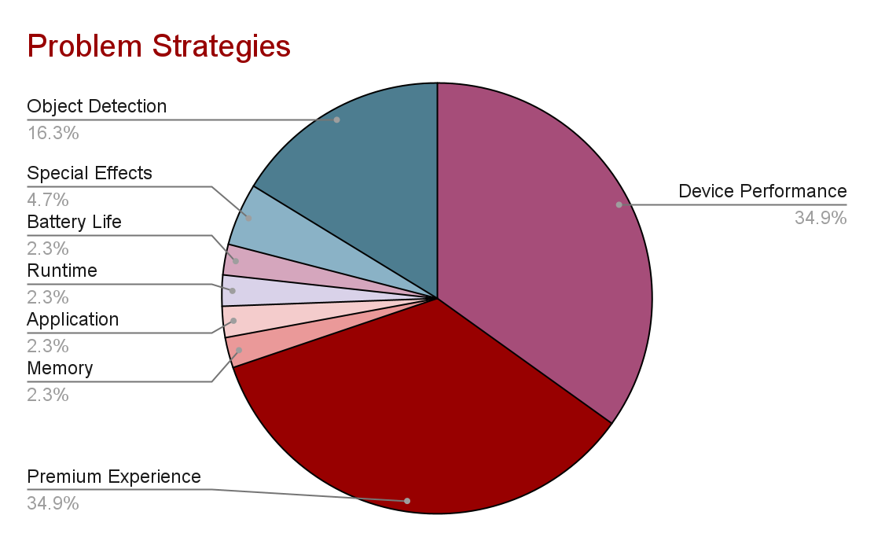
Conceptual Design

Slide 9
Final Design Description / Design
Successful AI training for detecting blackjack cards using Darknet.
Successful Unity program built.
C# script “GameLogic.cs” runs “blackjack.py” Python script using command prompt.
List data structure used to build a command line argument when running python script.
List example: < p, 10, 4, 3, d, 10, 9 >
User interface (UI) for blackjack displays correct probabilities for each player and dealer’s hand obtained.
Using darknet, after running a command on Windows Powershell, a webcam on the host computer is used to perform the playing card object detection.
Final design includes a losing sound effect, and when the player wins, a “raining coins” graphic effect.

Slide 10
Testing and Analysis Summary
The most difficult part of coding, is other people’s code
Testing on the probability algorithm “blackjack.py” python script, a Jupyter Notebook was used to call the code as a class to then test the class functions and logic.
For the Unity application, the debug console was used extensively to perform testing on the game logic.
Thanks to testing, it made it easier to detect and fix bugs found during the application development. [1]
Testing the object detection, mAP (mean Average Precision), metrics from training.
Testing raining coin effect by importing the FBX file into the unity project.
If Microsoft Hololens integration was successful, Windows Performance Analyzer would have been used to show the system and application performance.
Notes:
github link

Slide 11
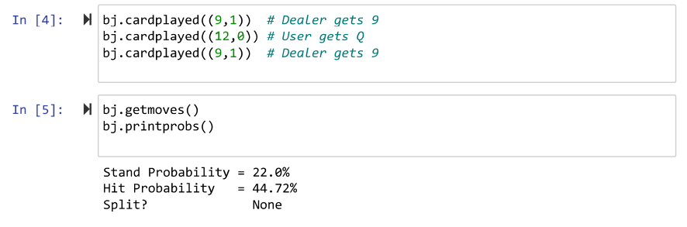
Testing and Analysis Summary

Slide 12
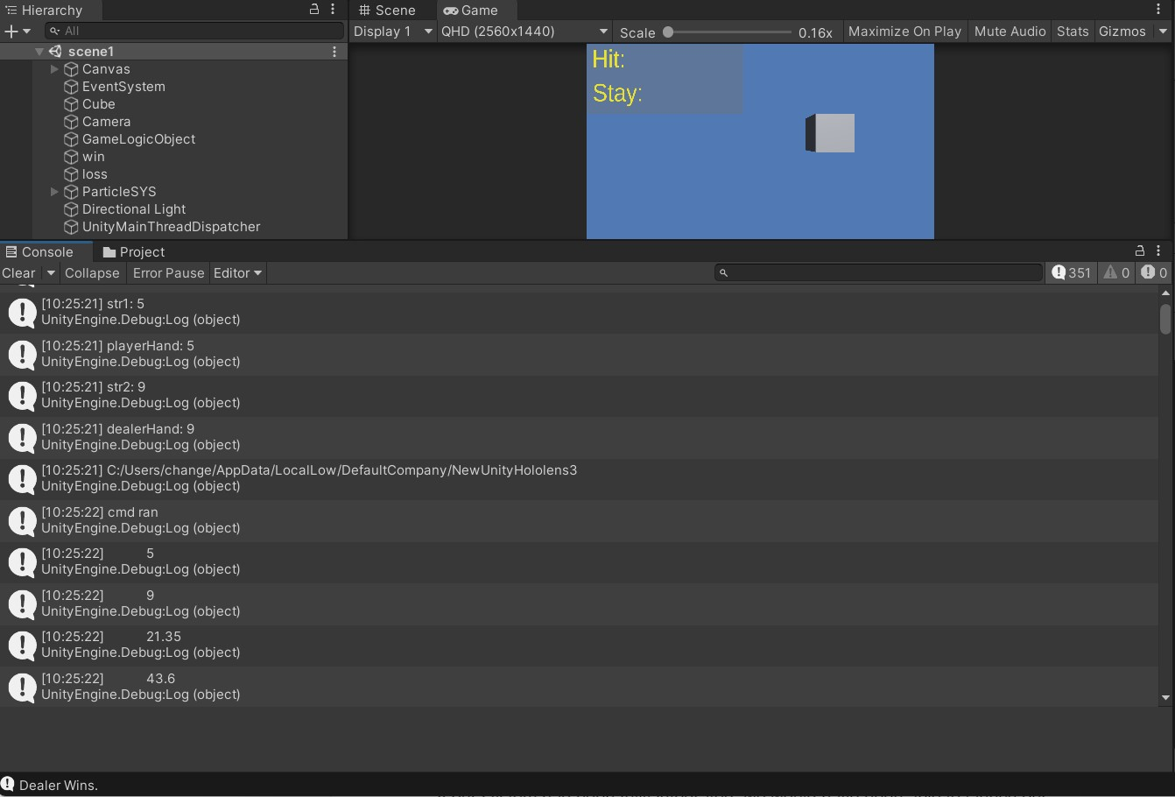
Testing and Analysis Summary

Slide 13
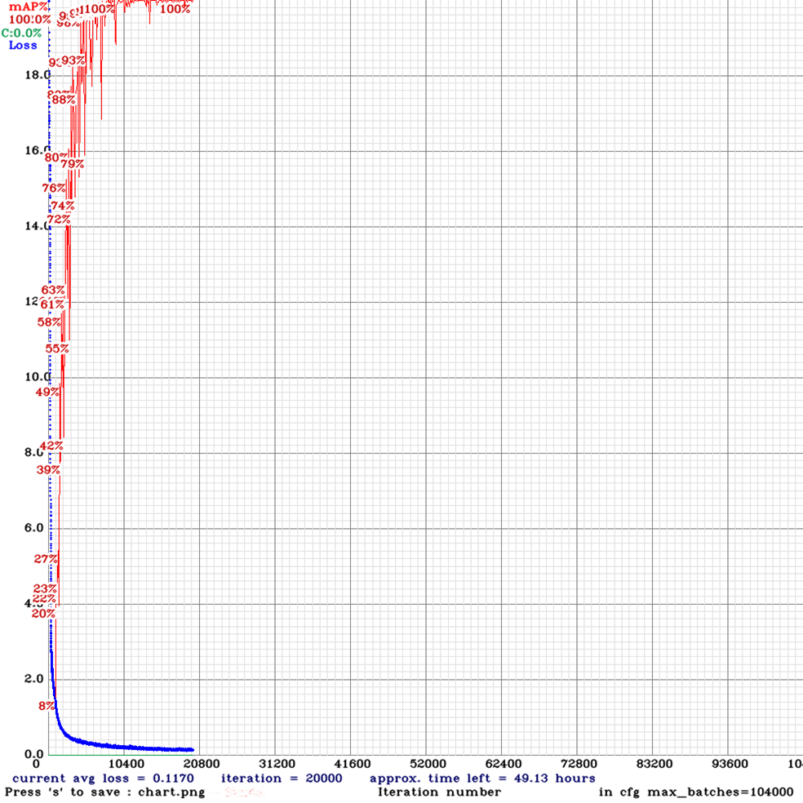
Testing and Analysis Summary

Slide 14
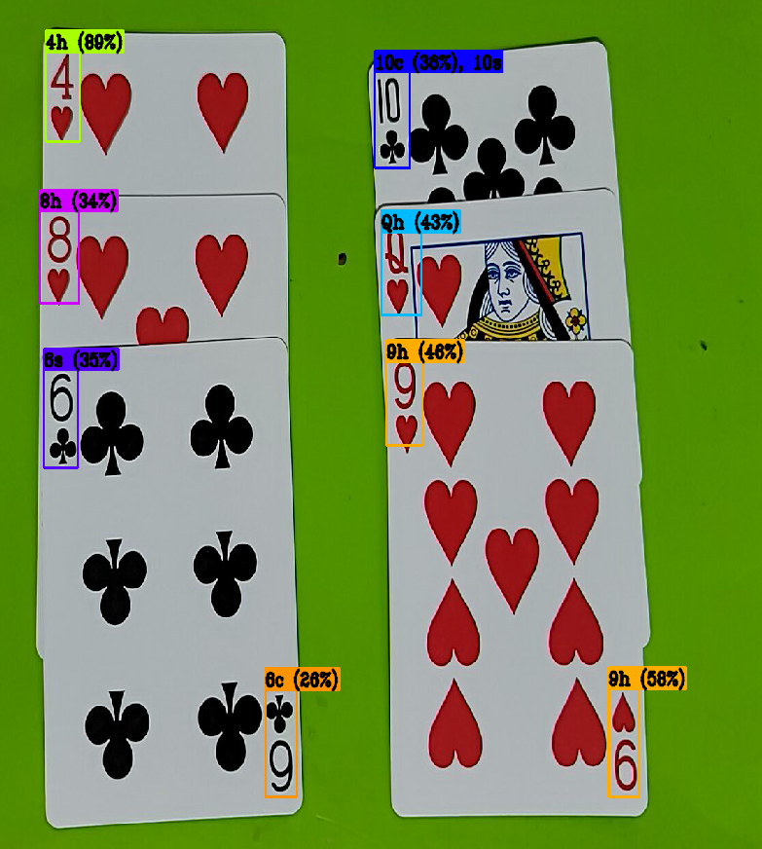
Object Detection
Project Flow
Training
Future

Slide 15
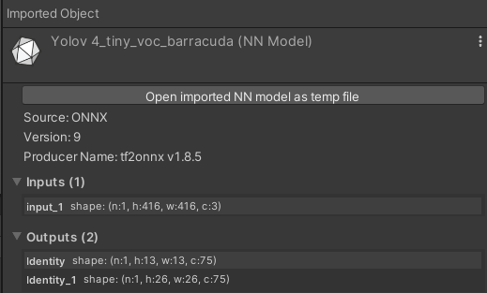
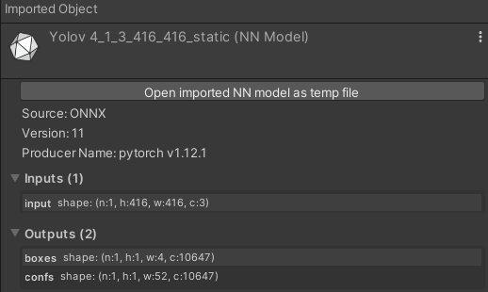
Object Detection - Project Lifetime Flow
You Only Look Once (YOLO) Algorithm [2]
YOLO v2 - Unity 2019 for HoloLens 1 [3]
ONNX v4 Conversion - Wrong Data [4]
YOLO v4 - Unity 2020 [5]
Notes:
n - batch size
c - # of channels
h/w - image size

Slide 16
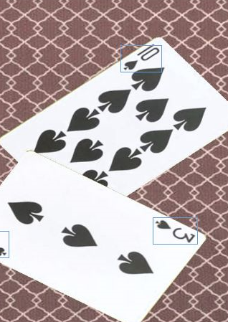
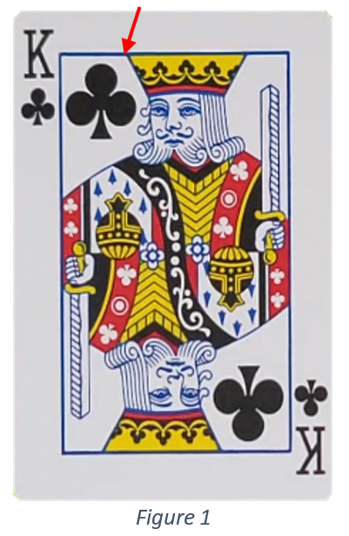
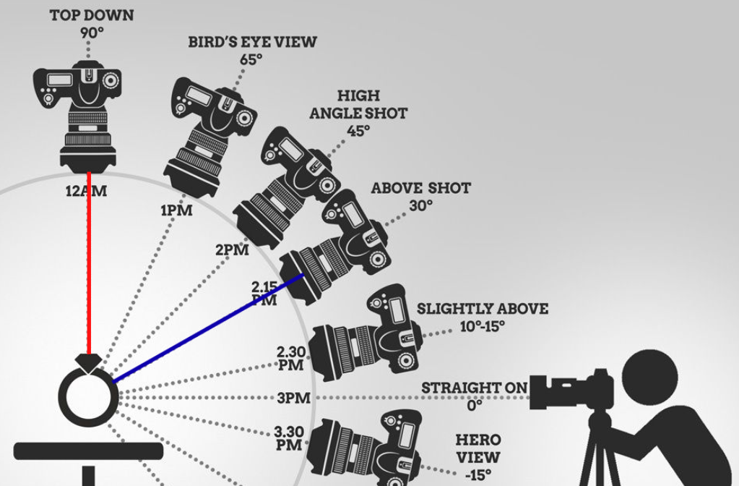
Object Detection - Training
Using [6] to format playing card data
Creates bounding boxes around corners
Use formatted data in darknet
Downside
Angle is 90°, ideally want 30°-65°
Figure 2
Figure 3

Slide 17
Object Detection - Future
Output ONNX File
Recognize cards in Unity
Integrate Object Recognition into game code
Run game code on HoloLens
Perform Testing on HoloLens

Slide 18
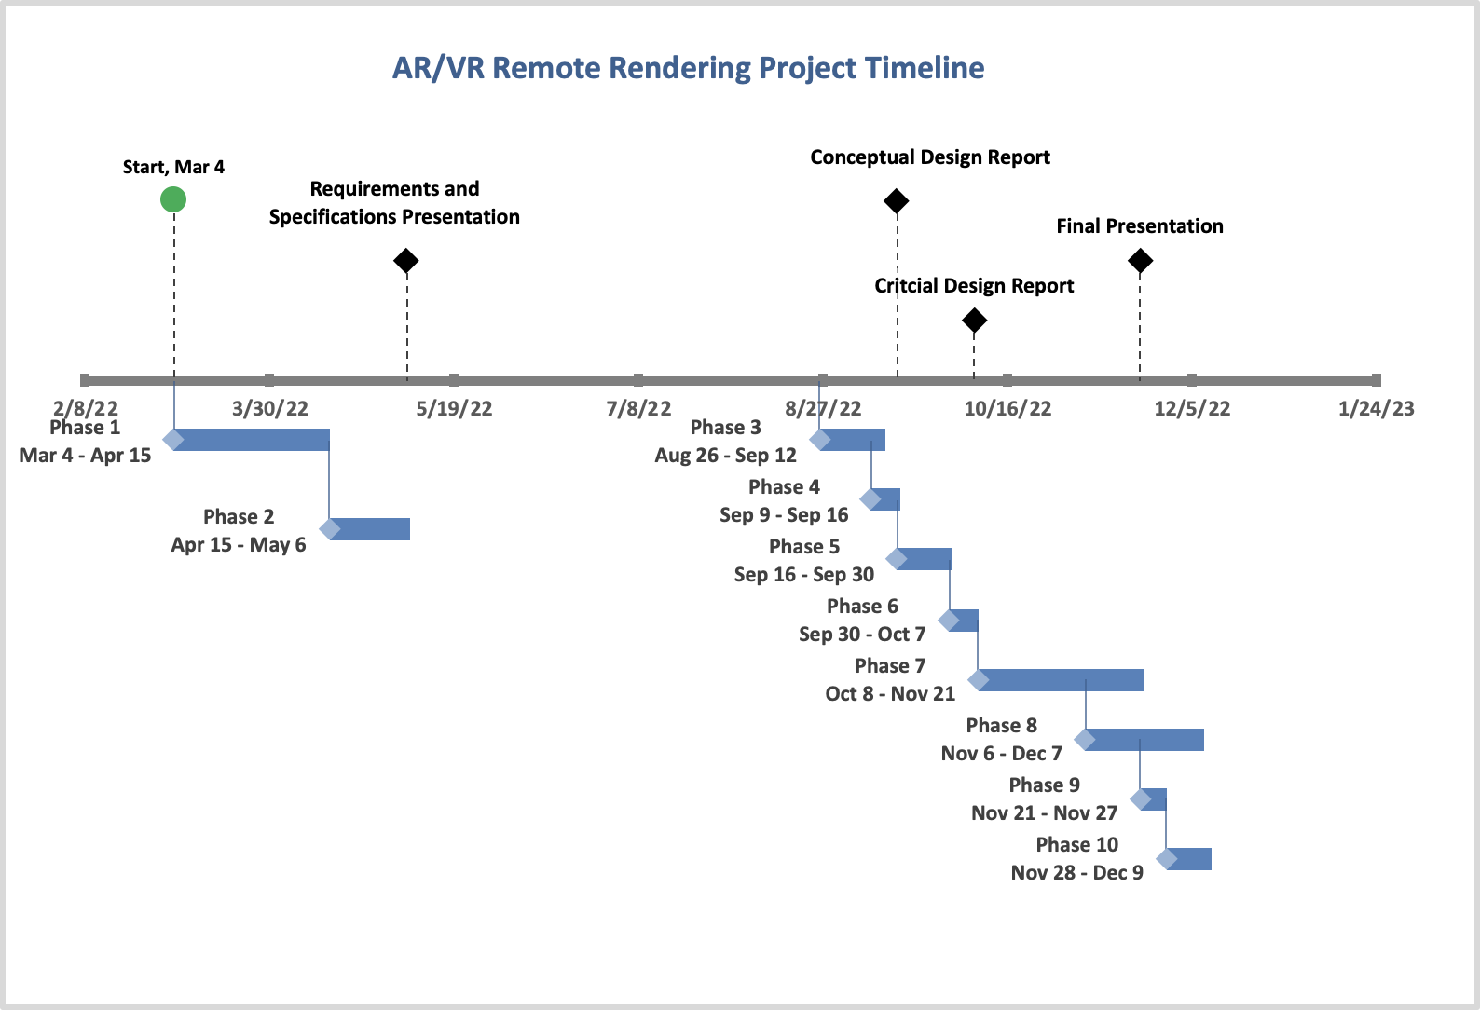
Project Planning and Management
Notes:
During this project our team experienced some issues with scheduling, as we were not able to get our application fully integrated within the amount of time we allotted for it. We planned for a monthly solely focused on developing and another month for troubleshooting bugs.
On the slide there is an overview of how our project was planned out and the different phases it went through.
Phase 1: We got our equipment, met with our Sponsor, and wrote our requirements and specifications document.
Phase 2 - 6: We worked on presentations and wrote our Conceptual-Design and Critical Design Reports.
Phase 7: We solely focused on completing our application as well as fixing bugs we found.
Phase 8 – 10: We wrote the testing report for the Conceptual-Design Report and completed or final report and presentation.
All of these phases are broken down further in our Gantt Chart

Slide 19
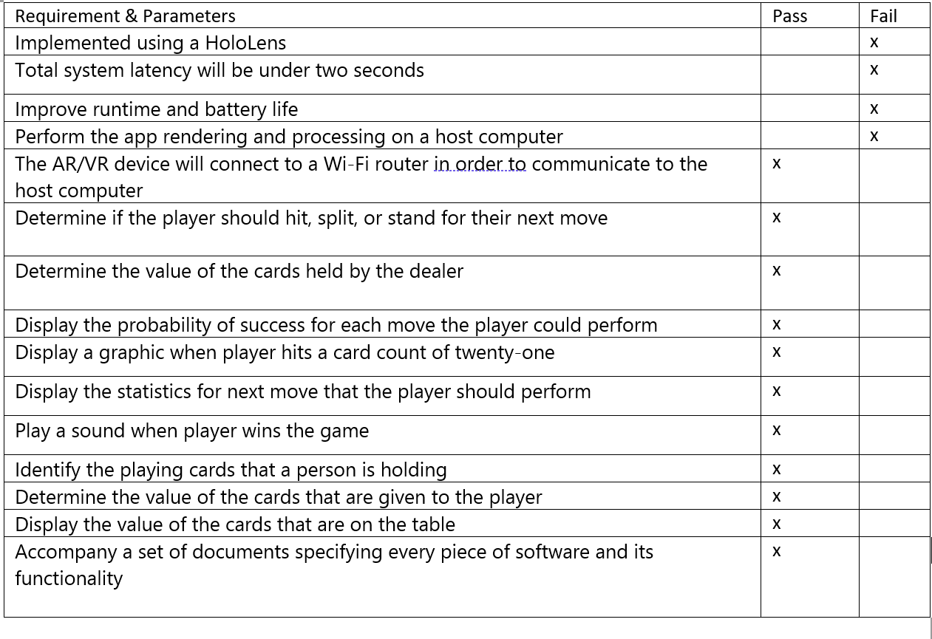
Conclusion
73.33% Success

Slide 20
References
[1] https://github.com/PimDeWitte/UnityMainThreadDispatcher
[2] https://github.com/AlexeyAB/darknet
[3] https://github.com/wojciechp6/YOLO-UnityBarracuda
[4] https://github.com/Tianxiaomo/pytorch-YOLOv4
[5] https://github.com/keijiro/YoloV4TinyBarracuda
[6] https://github.com/geaxgx/playing-card-detection
Notes:
github link

Slide 21
Any questions?
(Demo After)

Slide 22
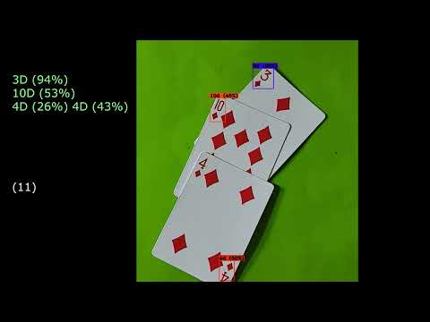

Slide 23
Thank You!

